Slide 1

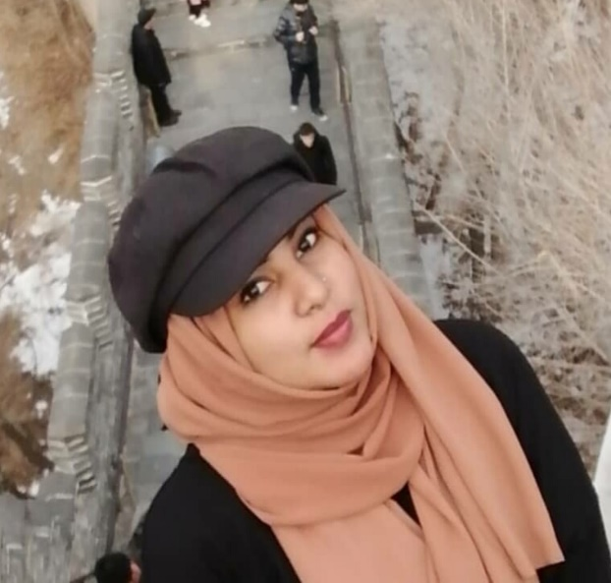






About
Me
PROFESSIONAL SKILLS
Client Confidentiality
Professional translator providing accuracy with deep understanding for both source and target languages. Well talented and Have ability transfer the exact meaning and taking consideration the culture of the reader who receiving the final text.
Interoperation Skills
Translation Software
Oral & Written Communication Skills
EDUCATION
AREA OF EXPERTISE
2014 - 2018
The Eligibility Bahri University – Bachelor of Chinese language.
Financial
Law & News
SAJA
Engineering
Oil
SaFWAT
2014 - 2016
Confucius Institute– Chinese language Course
Medical
Agriculture
1-Sep-2019 to 1-feb- 2020
LANGUAGES
Translator
Tianjin University– Chinese language Course
Sudanese
1995”
EXPERIENCES
Arabic
English
Chinese
1-Jan-2018 to 1-Apr-2018
Al-Hasaheisa , Gezira , Sudan
I worked at Mazerati Engineering Company – my Role was translate & manage files .
Passion and Hobbies
+249929000438
sajasafwat2020@gmail.com
1-Jan-2016 to 1-May-2016 -
I worked at Dolphin Design Company – my Role was translate & manage files .
Music
Photographing
Reading

